Slide 1
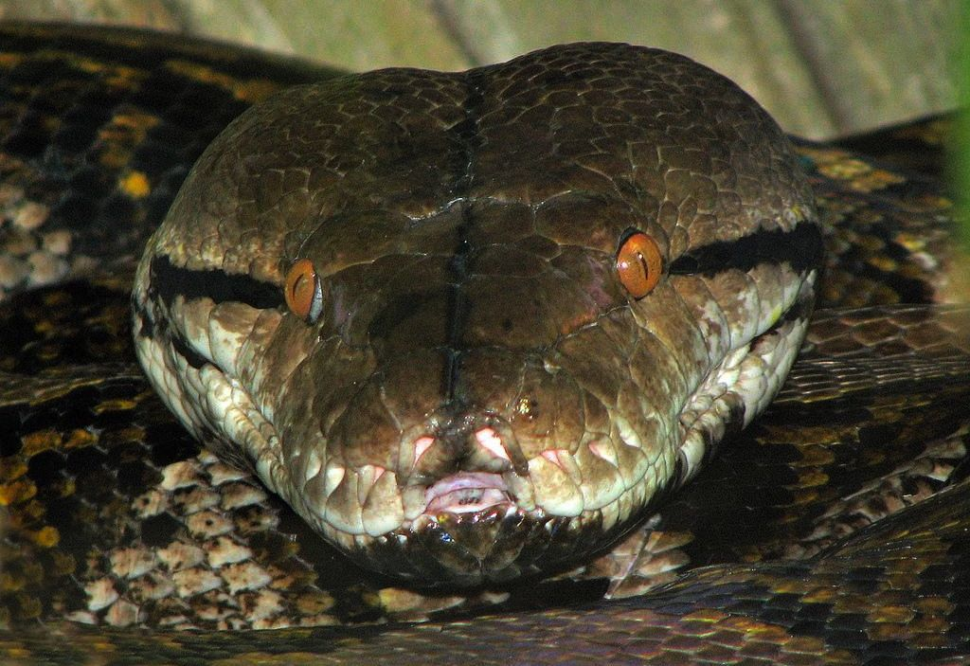
CHAPTER 14 STRINGS

Slide 2
Unit 2:
XI
Computer Science (083)
Board : CBSE
Computational Thinking and Programming
Courtesy CBSE

Slide 3
STRINGS

Slide 4
STRINGS
Like many other popular programming languages, strings in Python are arrays of bytes representing Unicode characters. However, Python does not have a character data type, a single character is simply a string with a length of 1. Square brackets can be used to access elements of the string.

Slide 5
How to change or delete a string?

Slide 6
How to change or delete a string?
Strings are immutable. This means that elements of a string cannot be changed once it has been assigned. We can simply reassign different strings to the same name.
>>> my_string = 'programiz'
>>> my_string[5] = 'a'
TypeError: 'str' object does not support item assignment.

Slide 7
How to create a string in Python?

Slide 8
STRINGS
How to create a string in Python?
Strings can be created by enclosing characters inside a single quote or double quotes. Even triple quotes can be used in Python but generally used to represent multiline strings and docstrings.

Slide 9
REPRESENTATION OF STRING

Slide 10
REPRESENTATION OF STRING
>>> s = “Hello Python”
This is how Python would index the string:
Backward Indexing
Forward Indexing

Slide 11
STRINGS – Programming Example

Slide 12
STRINGS - Example
Output Next Slide...

Slide 13
STRINGS - Example

Slide 14
How to access characters in a string?

Slide 15
STRINGS
How to access characters in a string?
We can access individual characters using indexing and a range of characters using slicing. Index starts from 0. Trying to access a character out of index range will raise an IndexError. The index must be an integer. We can't use float or other types, this will result into TypeError.

Slide 16
STRINGS
How to access characters in a string?
Python allows negative indexing for its sequences.
The index of -1 refers to the last item, -2 to the second last item and so on. We can access a range of items in a string by using the slicing operator (colon).

Slide 17
STRINGS – Programming Example

Slide 18
STRINGS

Slide 19
STRINGS

Slide 20
SLICING STRINGS EXAMPLES
For example:
>>>“Program”[3:5]
will result in:
‘gr ’
>>>“Program”[3:6]
will yield:
‘gra’
>>>p = “Program”
>>>p [:4]
‘Prog’
>>>p = “Program”
>>>p [4:]
‘ram’
>>>p = “Program”
>>>p [3:6]
‘gra’

Slide 21
Index Error!

Slide 22
STRINGS –Index error

Slide 23
More Functionality of String

Slide 24
More Functionality of String
>>> len(“Sainik School”)
13
>>>print(“Sainik” + “School”)
Sainik School
>>>print(“A” * 4 )
AAAA
>>>”sa” in “sainik”
True
>>>”pr” in “computer”
False
Finding Length of string
String Concatenation
String Repeat
Substring Tests

Slide 25
More Functionality of String
>>> name1="computer"
>>> name2=name1[3:5]
>>>name2
pu
String Slicing

Slide 26
String Methods

Slide 27
String Methods
In Python, a method is a function that is defined with respect to a particular object.
Syntax:
object.method(arguments)
For Example:
>>>name=“Classic”
>>>name.find(“s”)
3
the first position where “s” appears
String object
String Method
Method Argument

Slide 28
Built in Methods

Slide 29
1. capitalize() Method
Capitalizes first letter of string
First letter capitalization

Slide 30
2. lstrip() & 3. rstrip() Methods
lstrip() method is used to remove left padded spaces in a given string
>>>name1=“ a “
>>>name1.lstrip()
‘a ‘
rstrip() method is used to remove right padded spaces in a given string
>>>name1.rstrip()
‘ a’
Removing left spaces
Removing right spaces

Slide 31
4. strip() Method
strip() method is used to remove left and right padded spaces in a given string
>>>name1=“ a “
>>>name1.strip()
‘a‘
Removing left and right spaces for a given string

Slide 32
5. lower() Method
lower() method is used to convert given string in to lower case.
>>>name1=“ SAINIK “
>>>name1.lower()
sainik
Converting in to lower case

Slide 33
6. upper() Method
upper() method is used to convert given string in to upper case.
>>>name1=“ sainik “
>>>name1.upper()
SAINIK
Converting in to upper case

Slide 34
7. title() Method
title() method is used to convert given string in to title case. Every first chatacter of word of a given string is converted to title case.
>>>name1=“ praveen murigeppa jigajinni“
>>>name1.title()
Praveen Murigeppa Jigajinni
In every word first letter is capitalized

Slide 35
8. swapcase() Method
swapcase() method is toggle the case.
Meaining upper to lower and lower to upper case.
>>>name1=“ PrAvEeN“
>>>name1.swapcase()
pRaVeEn
Every character case is changed

Slide 36
9. ljust() Method
ljust() method is used to add spaces to the left side of the given string
>>>name1=“ Jigajinni“
>>>name1.ljust(15)
‘Jigajinni ’
Left side padded with spaces
Note: string length is 9 and 6 spaces added to the left side of string

Slide 37
10. rjust() Method
rjust() method is used to add spaces to the right side of the given string
>>>name1=“ Jigajinni“
>>>name1.rjust(15)
‘ Jigajinni’
Right side padded with spaces
Note: string length is 9 and 6 spaces added to the right side of string

Slide 38
11. center(width, fillchar) Method
The method center() returns centered in a string of length width. Padding is done using the specified fillchar. Default filler is a space.
Centered string

Slide 39
12. zfill() Method
zfill() method is used to fill the zero to a given string
>>>name1=“ 123“
>>>name1.zfill(15)
‘00123 ’
Filling Zeros

Slide 40
13. find() Method
find() method is used to find a perticular character or string in a given string.
>>> name1="praveen"
>>> name1.find("e")
4
e is present at 4th location (first appearance) in a given string

Slide 41
14. count() Method
count() method is used to the number of times character or string appears in a given string.
>>>name1=“praveen“
>>>name1.count(“e”)
2
2 times e appears in a given string

Slide 42
15. stratswith() Method
startswith() method is used check string start with particular string or not
>>>name1=“praveen“
>>>name1.startswith(“a”)
False
Given string not starting with “a”

Slide 43
16. endswith() Method
endswith() method is used check string ends with particular string or not
>>>name1=“praveen“
>>>name1.endswith(“en”)
True
Given string ends with “en”

Slide 44
17. isdigit() Method
isdigit() method is used check string is digit (number) or not and returns Boolean value true or false.
>>>name2=“123”
>>>name2.isdigit()
True
>>name1=“123keyboard“
>>name1.isdigit()
False
Given string is number
Given string not number so false

Slide 45
18. isnumeric() Method
isnumeric() is similar to isdigit() method and is used check string is digit (number) or not and returns Boolean value true or false.
>>>name2=“123”
>>>name2.isnumeric()
True
>>name1=“123keyboard“
>>name1.isnumeric()
False
Given string is number
Given string not number so false

Slide 46
19. isdecimal() Method
isnumeric(),isdigit() and isdecimal() methods are used to check string is digit (number) or not and returns Boolean value true or false.
>>>name2=“123”
>>>name2.decimal()
True
>>name1=“123keyboard“
>>name1.isnumeric()
False
Given string is number
Given string not number so false

Slide 47
20. isalpha() Method
isalpha() method is used check string is digit or not and returns Boolean value true or false.
>>>name2=“123”
>>>name2.isalpha()
False
>>name1=“123computer“
>>name1.isalpha()
False
>>>name3=“Keynoard”
>>>Name3.isaplpha()
True
Given string does not contain string
Given string not string it contains digits
It’s a string

Slide 48
21. isalnum() Method
isalnum() method is used check string is alpha numeric string or not.
>>>name2=“123”
>>>name2.isalnum()
True
>>>name1=“123computer“
>>>name1.isalnum()
True
>>>name3=“Praveen”
>>>name3.isalnum()
True
Given string is alpha numeric

Slide 49
22. islower() Method
islower() method is used check string contains all lower case letters or not, it returns true or false result.
>>>name2=“Praveen”
>>>name2.islower()
False
>>>name1=“praveen“
>>>name1.islower()
True
Given string is not lower case string
Given string is lower case string

Slide 50
23. isupper() Method
isupper() method is used check string contains all letters upper case or not, it returns true or false result.
>>>name2=“Praveen”
>>>name2.isupper()
False
>>>name1=“PRAVEEN“
>>>name1.isupper()
True
Given string is not upper case string
Given string is upper case string

Slide 51
24. isspace() Method
isspace() method is used check string contains space only or not.
>>>name2=“ ”
>>>name2.isspace()
True
>>>name1=“PRAVEEN M J“
>>>name1.isspace()
False
Given string contains space only
Given string not containing space only

Slide 52
25. find() Methods
find() method is used to find a particular string (substring) in a given string.
>>>name=“Classic”
>>>name.find(“s”)
3
the first position where “s” appears
String object
String Method
Method Argument

Slide 53
26. str() Method
str() method is used convert non string data into string type.
>>>str(576)
‘576’
576 is number converted to string

Slide 54
27 len() Method
len() method is used get a length of string.
>>>len(“Praveen”)
7
Gives the string length

Slide 55
28 max() Method
max() method is used get a max alphabet of string.
>>>max(“Praveen”)
v
Gives max character

Slide 56
29 min() Method
min() method is used get a max alphabet of string.
>>>min(“Praveen”)
P
Gives min character P because it has ASCII Value 65

Slide 57
30 split() Method
split() method is used split a string.
Split in to several words or substrings

Slide 58
30 split() Method
split() method is used split a string according to delimiter.
Split in to several words or substrings according to delimiter

Slide 59
31 index() Method
Same as find(), but raises an exception if str not found.
>>> name="Sainik“
>>> name.index("a",3,5)
ValueError: substring not found
>>> name.index("a",1,5)
1
Value error
Character found, returning the position

Slide 60
Character Methods

Slide 61
32. ord() Method
ord() method is used get a ASCII value for a character.
>>ord(“a”)
97
97 is the ASCII value for character ‘a’

Slide 62
33. chr() Method
char() method is used get a character for an ASCII value.
>>chr(97)
‘a’
‘a’ ASCII value is 97

Slide 63
Class Test

Slide 64
Class Test
Time: 40 Min Max Marks: 20
What is string? 02
What is forward indexing and back word indexing? 03
Explain any 5 string built in methods 10
What are character methods? Explain in detail 05

Slide 65
Thank You

